Slide 1
Returning Cannabis to the Medicine Cabinet?
Professor Les Iversen
University of Oxford

Slide 2
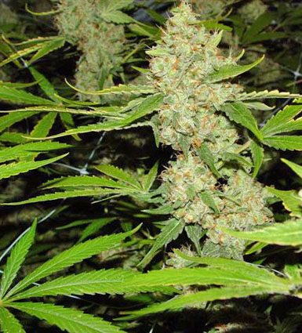
Female Cannabis Flower

Slide 3
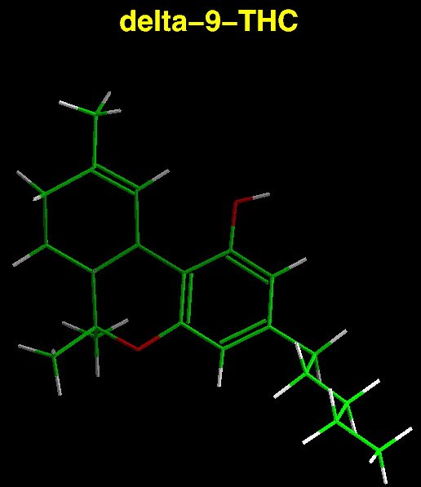

Slide 4
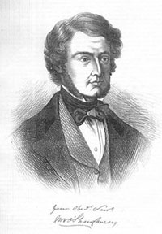

Slide 5
William O’Shaughnessy – a Victorian Genius
1832 – (age 22) idea for fluid/electrolyte replacement in cholera
1833-Joined East India Company in Calcutta as physician, surgeon, professor of Chemistry and scientist –validated folk use of cannabis
1841 – Return to England and popularised cannabis medicines
1844- Returned to India and installed 3500 miles of telegraph network

Slide 6
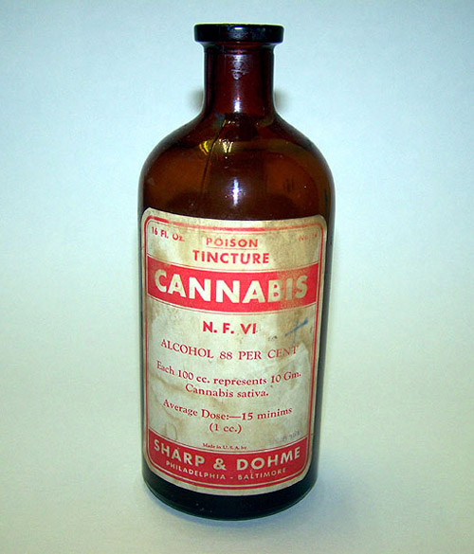
Tincture of Cannabis

Slide 7
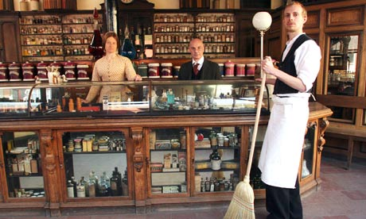

Slide 8
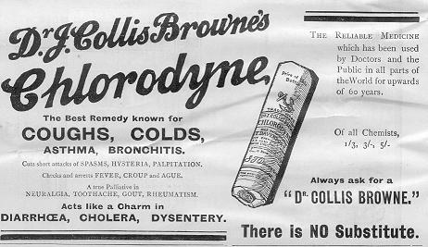

Slide 9
BRITISH MEDICAL JOURNAL 9 MARCH 1974
Chlorodyne Dependence
R. R. PARKER, J. P. COBB, P. H. CONNELL,
British Medical_Journal, 1974, 1, 427-429
Summary
Eight cases of chlorodyne dependence seen in a London drug
clinic are described. These cases and the results of an inquiry
among pharmacies in central and south London suggest that
this form of drug dependence is commoner among younger
people than has been supposed and that the total number of
chlorodyne-dependent people in Greater London may exceed
1,000. The prognosis for cure is poor. We recommend that
the supply of chlorodyne, now available without prescription
to the public, should be restricted.

Slide 10
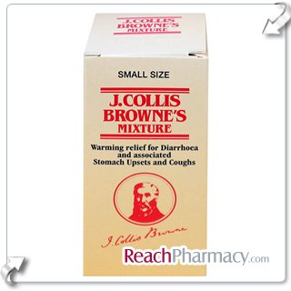

Slide 11
Receptors for THC
CB1 receptor principal type in CNS
CB2 receptor in peripheral nerves and immune system
CB1 receptor antagonist rimonabant (SR171614A) blocks all psychoactive actions of THC or cannabis.
CB1 receptor knockout mice no longer respond to pain-relieving effects of THC

Slide 12
CB Receptor Agonists Licensed for Clinical Use
OH
Dronabinol = ®Marinol = Δ⁹-THC
(2.5 mg capsules)
O
THC
USA
Yes
Yes
Nabilone
UK*
Yes
No
Country
Anti-emetic
Appetite stimulant
O
OH
*Also
Canada
Nabilone = ®Cesamet
(1 mg capsules)
O

Slide 13
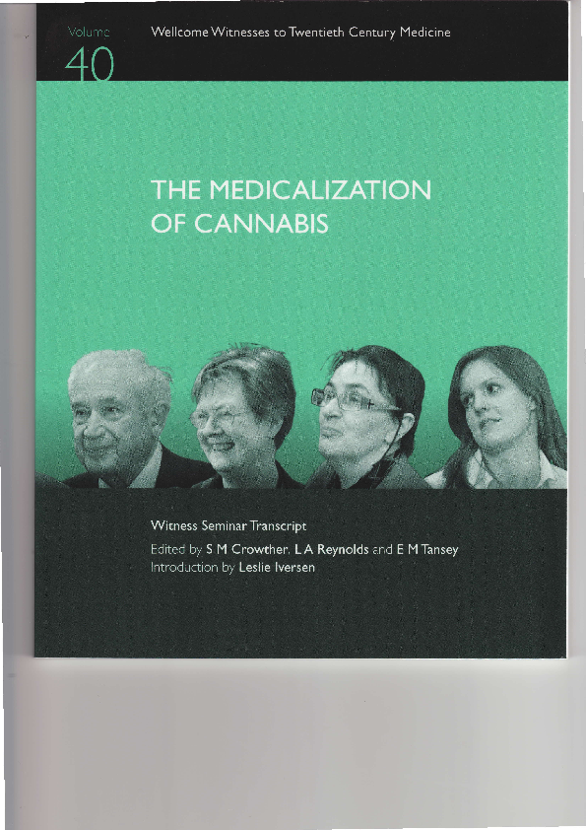
Wellcome History of Medicine

Slide 14
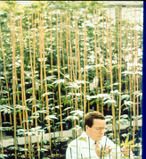
G.W.PHARMA
Legal cannabis
plants

Slide 15
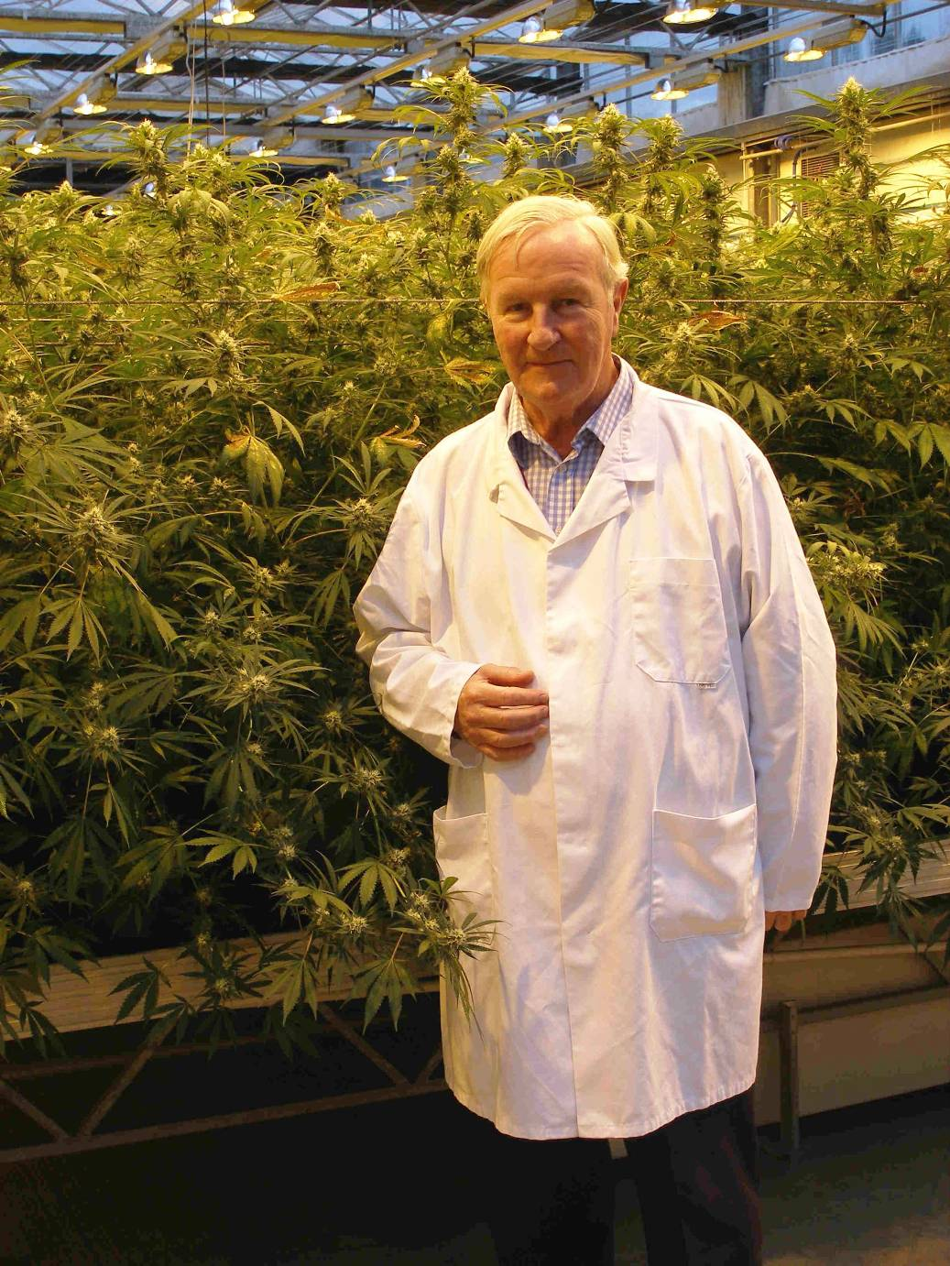

Slide 16
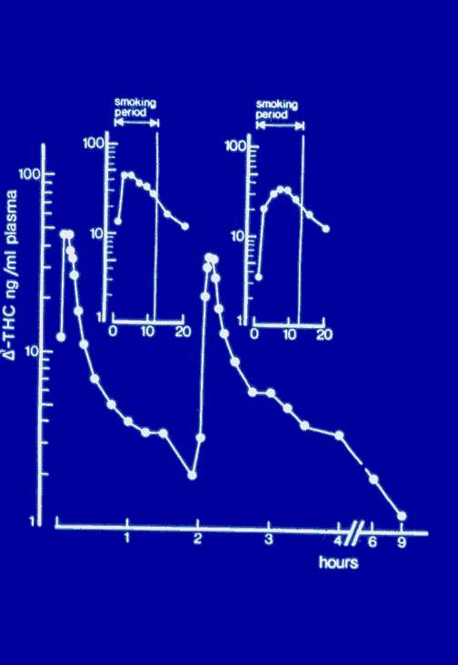
Smoking delivers
THC efficiently
Is Vaporisation
An Alternative?

Slide 17
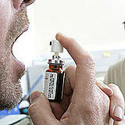
Sativex sublingual metered dose spray: GW Pharma

Slide 18
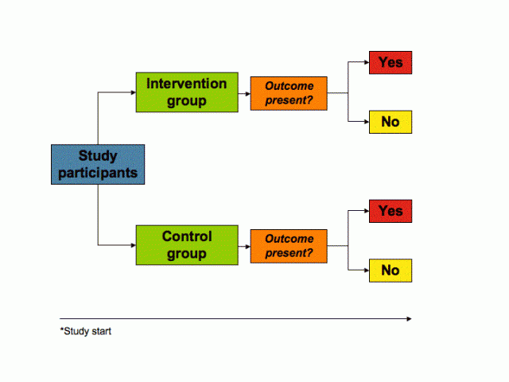
Randomised controlled clinical trial

Slide 19
Cannabis and Pain
Pain relief in various animal models, especially of neuropathic pain
Effects blocked by rimonabant or in CB1 knockout mice
Interactions with opioid mechanisms, synergistic in nature

Slide 20
Central neuropathic pain in MS:
Change in BS-11 Pain Score: GW Pharma
Mean BS-11 Pain Score
Mean Treatment Difference = -1.25
(95%CI: -2.11, -0.39) p = 0.005

Slide 21
Cannabis and Multiple Sclerosis
Effective in animal models of muscle spasm/rigidity
Anecdotal evidence for use by MS patients
Results of MRC-sponsored trial in 630 patients
Cannabis extract orally compared with placebo or pure THC. Cannabis and THC improved patients’ perception of muscle spasm and pain, but no objective benefit on spasticity scale until 12 months.
Benefits appear marginal but real

Slide 22
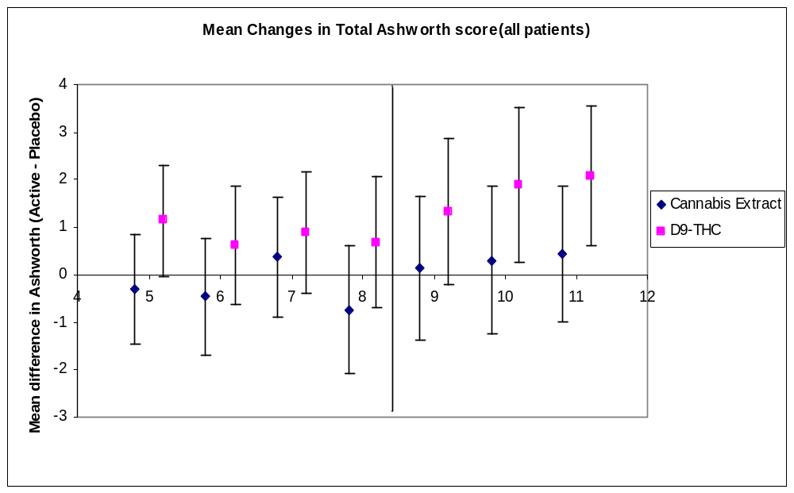
Results of MRC trial in MS
Zajicek et al 2005, J Neurol.Neurosurgery Psychiatry,76:1664

Slide 23
Other Actions of THC
Powerful anti-emetic actions in animals and man. THC approved for treatment of chemotherapy-induced nausea/vomiting
Cannabis stimulates appetite, especially for sugar/fat-rich foods. Approved for AIDS wasting syndrome in USA
CB1 antagonist RIMONABANT reduces body weight and “metabolic syndrome” markers –partly by acting on liver & fat cells.
Rimonabant withdrawn because of low incidence adverse psychiatric side effects

Slide 24
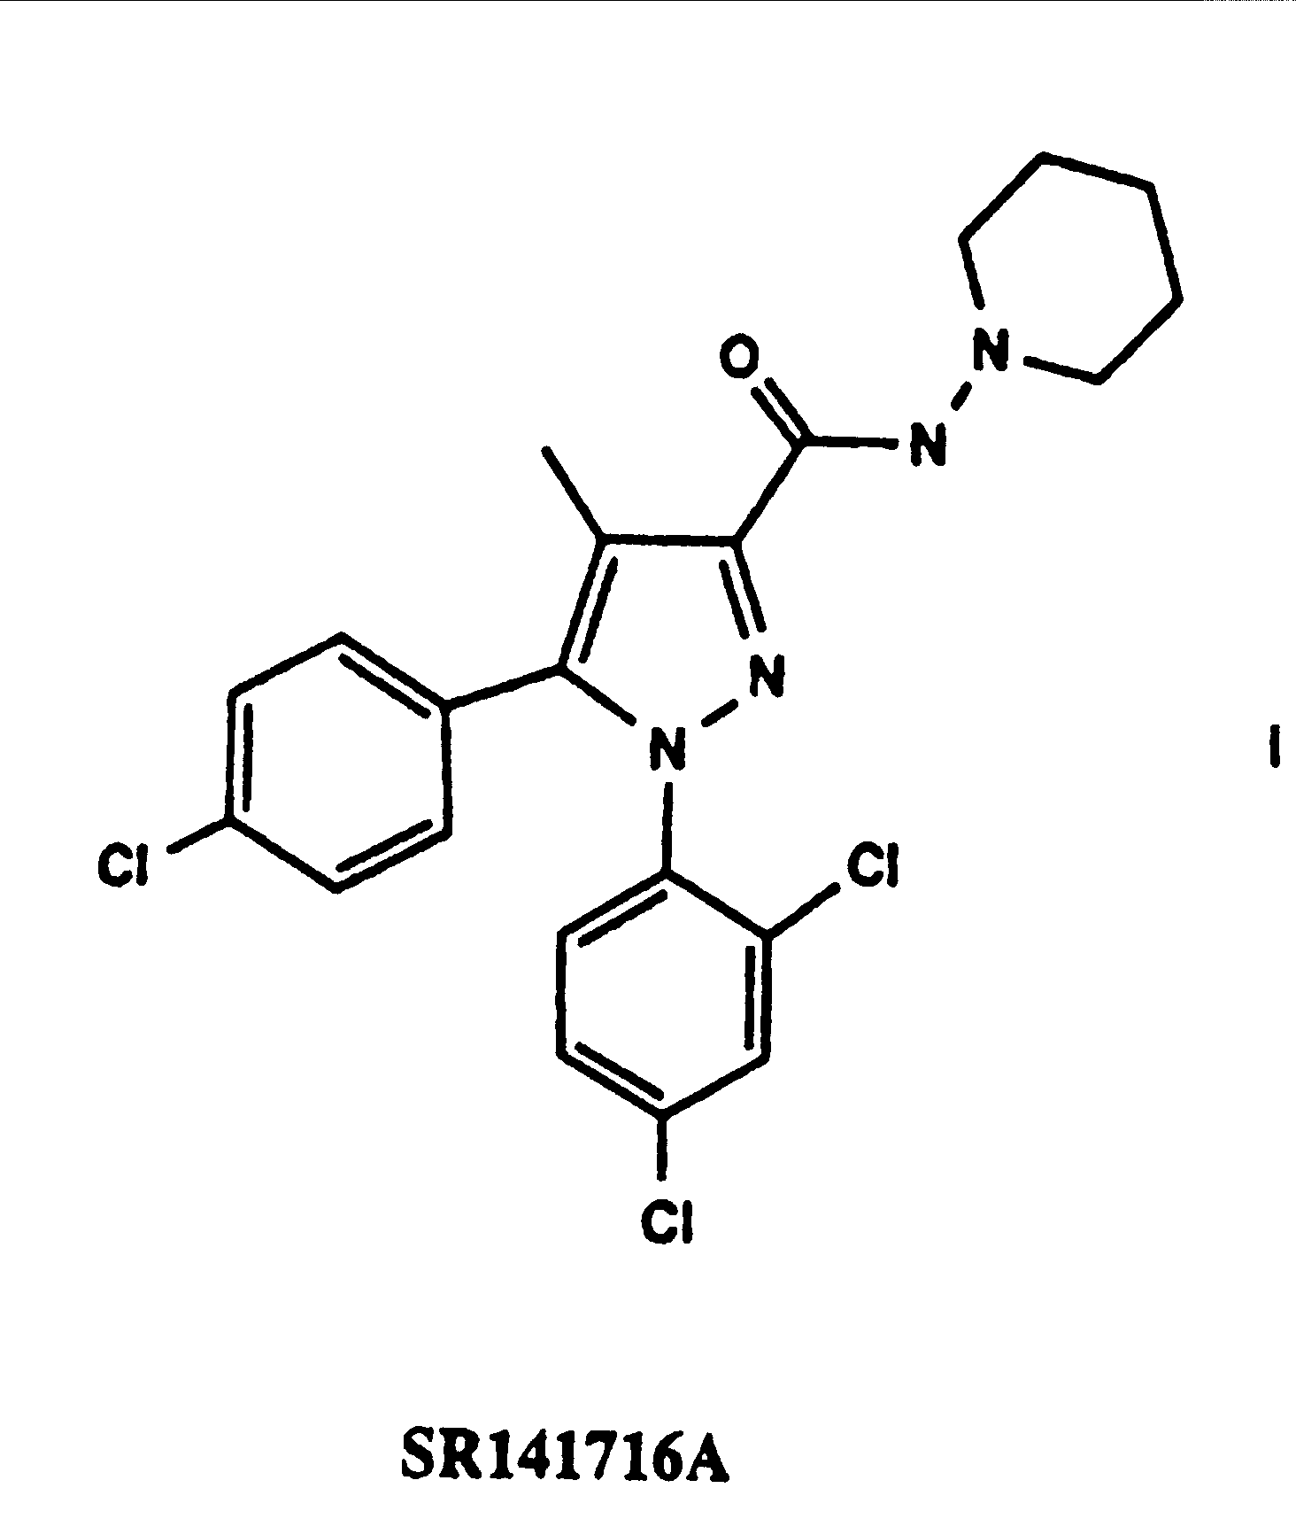
RIMONABANT:
Sanofi Aventis SR141716A

Slide 25
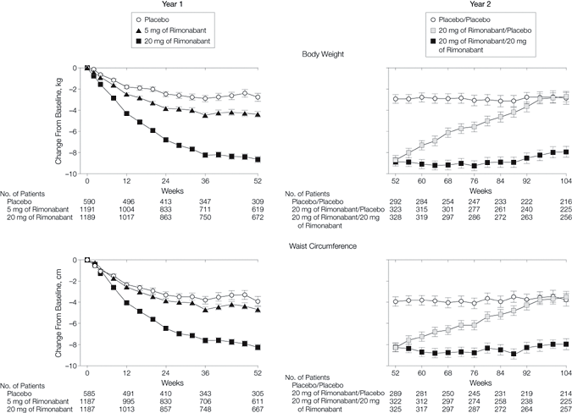
Rimonabant clinical trial data:
JAMA,2006,295:768

Slide 26
The end of rimonabant
USA Food and Drug Administration refused approval of rimonabant because of a low incidence of psychiatric side effects
EU ordered withdrawal of rimonabant from market, Feb 2009, because of possible link to suicides
End of an expensive story

Slide 27
Cannabis medicine - Netherlands
Herbal cannabis (known as ‘cannabis flos’), with a nominal THC content of 18 %, is available as a prescription medicine in The Netherlands. It is indicated for multiple sclerosis, certain types of pain and other neurological conditions

Slide 28
Cannabis Medicine - Canada
Medical grade smoking cannabis available on prescription
“Sativex” approved for treatment of pain associated with cancer or multiple sclerosis

Slide 29
Medical Cannabis USA
15 States have approved cannabis pharmacies to provide cannabis to patients with doctor’s prescription, and other states considering .
But the Federal US Government continues to view cannabis as illegal.
Cannabis Science Inc is a company formed to provide standardised medical grade herbal cannabis

Slide 30
Center for Medicinal Cannabis Research, University of California www.cmcr.ucsd.edu
State of California provided a research grant of $9 million in 2000
Sponsored controlled clinical trials of smoked cannabis, using standardised product
Five studies completed so far confirm pain-relieving and anti-spasticity effects of cannabis.

Slide 31
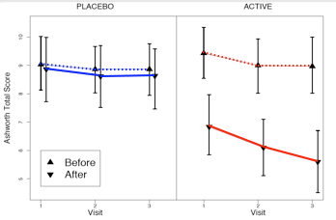
Smoked marijuana in MS
J.Corey-Bloom,ACNP Abstracts,2007

Slide 32
Cannabis Medicine UK
Illegal herbal cannabis used by many patients suffering pain and spasticity of MS
MRC sponsored clinical trial involving >600 MS patients showed efficacy of oral THC in treating spasticity.
“Sativex” approved as prescription medicine, June 2010, for treatment of spasticity in multiple sclerosis (MS)

Slide 33
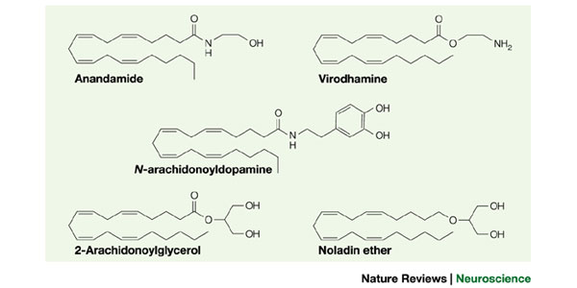
Endocannabinoids

Slide 34
New Drugs to Modulate Cannabinoid Function?
Up-regulate cannabinoid function by blocking inactivation of anandamide by uptake or enzymic (FAAH) mechanisms
Metabolically stable analogues of anandamide
CB2 selective agonists as analgesics
Clinical uses of peripherally acting CB1 receptor antagonists

Slide 35
