Slide 1



Peter Reynolds
This Photo by Unknown Author is licensed under CC BY-SA

Slide 2
Peter Reynolds
Founded 1999
Approx 750,000 followers
5,000 paid members
This Photo by Unknown Author is licensed under CC BY-SA

Slide 3

Peter Reynolds
The trade association for the UK’s cannabis, CBD and hemp businesses
This Photo by Unknown Author is licensed under CC BY-SA

Slide 4
Aims and Objectives
To end the prohibition of cannabis.
To promote as a matter of urgency and compassion the prescription of medicinal cannabis by doctors.
To introduce a system of regulation for the production and supply of cannabis based on facts and evidence.
To encourage the production and use of industrial hemp.
To educate and inform about the uses and benefits of cannabis.
This Photo by Unknown Author is licensed under CC BY-SA

Slide 5
The UK’s Legal Cannabis Industry
Cultivated for millennia. As common on the land as wheat or barley
1928 Cannabis possession banned
1964 Cannabis cultivation banned
1993 Industrial hemp licensing introduced
2010 Sativex granted marketing authorisation
2012 Start of the CBD industry
2018 CBPMs defined and placed in schedule 2
This Photo by Unknown Author is licensed under CC BY-SA

Slide 6
The UK’s CBD Industry
How to enjoy medicinal benefits of cannabis legally
Now worth at least £50 million pa
Major driver of cannabis law reform
Major influence on the 2018 medical access reform
Destigmatising cannabis
This Photo by Unknown Author is licensed under CC BY-SA

Slide 7
The UK’s CBD Industry
Must not make claims of medicinal benefit for CBD products
YET
Virtually all CBD products are bought for medicinal purposes
This Photo by Unknown Author is licensed under CC BY-SA

Slide 8
The UK’s CBD Industry
Justified intervention from MHRA
Opposition from medical establishment
Opposition from big business establishment
Threat to pharmaceutical industry
Unjustified intervention from FSA
Bureaucrats responding to lobbying by vested interests
This Photo by Unknown Author is licensed under CC BY-SA

Slide 9
FSA Intervention
Novel foods legislation is about safety
FSA has no evidence CBD products are unsafe
WHO has unequivocally declared CBD safe
Intervention made surreptitiously through EU when UK is on the brink of Brexit
This Photo by Unknown Author is licensed under CC BY-SA

Slide 10
If bureaucrats have so much time on their hands, why not start on the regulation of the £6 billion criminal cannabis market?
This is something that really needs doing!
This Photo by Unknown Author is licensed under CC BY-SA

Slide 11
Why Cannabis Professionals?
MHRA intervention
CLEAR forced MHRA response
Creation of Cannabis Trades Association
Two years intensive work as part of CTA
This Photo by Unknown Author is licensed under CC BY-SA

Slide 12
Why Cannabis Professionals?
Resignation from CTA
Love Hemp resignation from CTA
Aim to support and nurture the industry without exploiting it
This Photo by Unknown Author is licensed under CC BY-SA

Slide 13
No membership fees at present
One-off £120 application fee for CannaPro Certification
All advice and guidance published openly
Inclusive not exclusive
Co-operative advertising campaign
This Photo by Unknown Author is licensed under CC BY-SA

Slide 14
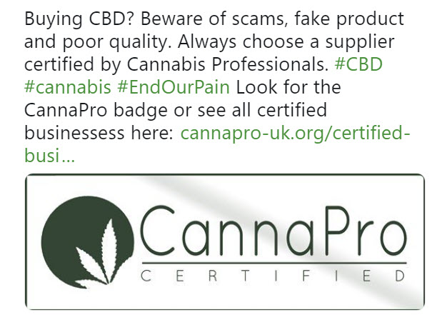

Slide 15
Why Cannabis Professionals?
Follow CannaPro for all the latest news
CannaPro represents the industry to the authorities, not vice versa
This Photo by Unknown Author is licensed under CC BY-SA

Slide 16
Why Cannabis Professionals?
A balance, sensible approach to compliance
Future development of CBPMs, THR and VMD licensed products
This Photo by Unknown Author is licensed under CC BY-SA

Slide 17
Peter Reynolds
Long term objective – to close down CLEAR
This Photo by Unknown Author is licensed under CC BY-SA

Slide 18
THE END
When adults have legal access to cannabis for all purposes, including the right to grow it for themselves.
This Photo by Unknown Author is licensed under CC BY-SA

